Slide 1

FY18
District Goals Dashboard
October 23, 2017

Slide 2
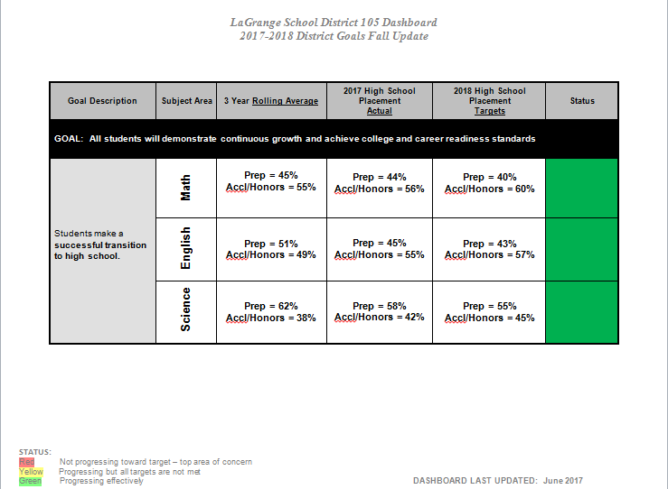
Dashboard

Slide 3
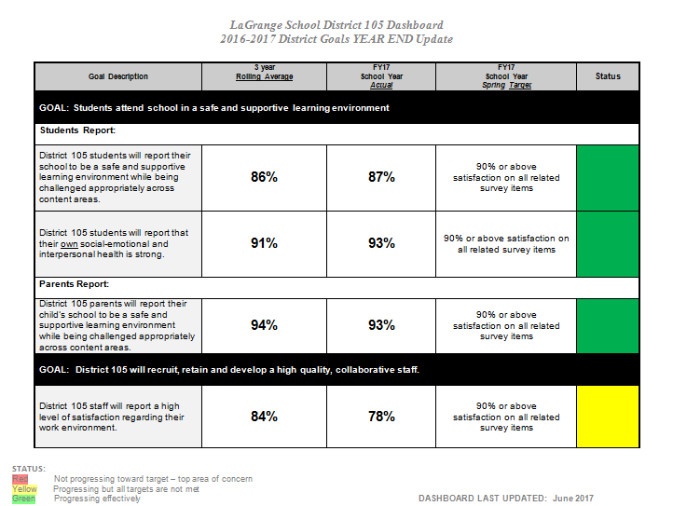

Slide 4
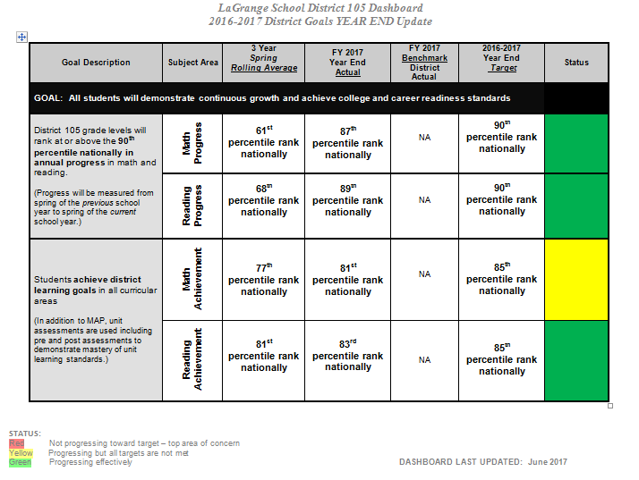

Slide 5
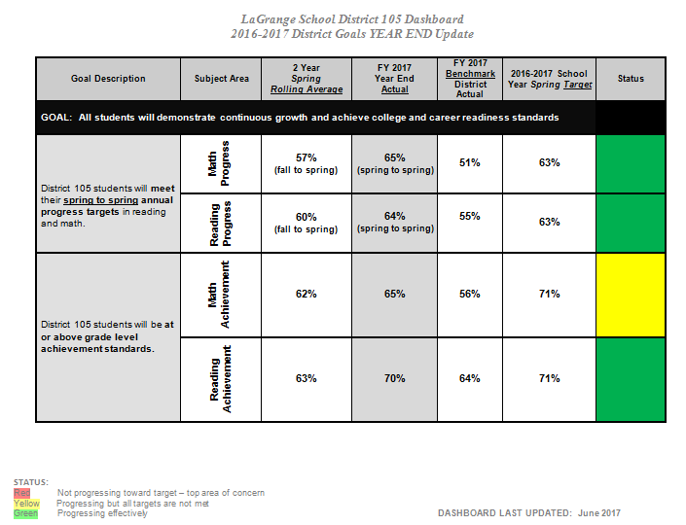

Slide 6
FY17 District Progress Results
Math and Reading Progress by Percentile Ranges

Slide 8
Notes:
Growth rates that would have been considered adequate growth in 2011 norms were no longer adequate in the 2015 norms
So we did not have as high a percentage of students meet growth targets based on the new 2015 norms

Slide 13
FY17 District Progress Results
GAN: Progress of Highest Achievers
FY17 Math and Reading Data

Slide 16
FY17 Spring District MAP Cohorts
FY17 Spring Math and Reading Data

Slide 17
FY 17 Cohort Study
In general, the longer students are in District 105, the better they perform against their national peers in reading. This pattern holds for low income and Hispanic students.
The cohort achievement patterns in math are more inconsistent. This holds true for low income and Hispanic students.
The cohort study reveals the Achievement Gap in math and reading.
The 8th grade cohort of students achieved at the highest levels since we have been studying cohorts of students. This historically high achievement level included low income and Hispanic students.

Slide 18
District 4th Grade Cohort - Percentage of students at or above 50th percentile n=130

Slide 19
4th Grade Low Income (48) and Hispanic (47) Cohorts – Percentage at or above the 50th percentile on spring MAP.

Slide 20
District 5th Grade Cohort - Percentage of students at or above 50th percentile n=122

Slide 21
5th Grade Low Income (48) and Hispanic (47) Cohorts – Percentage at or above the 50th percentile on spring MAP.

Slide 22
District 6th Grade Cohort Percentage of students at or above 50th percentile on spring MAP n=109

Slide 23
6th Grade Low Income (39) and Hispanic (37) Cohorts – Percentage at or above the 50th percentile on spring MAP.

Slide 24
District 7th Grade Cohort – Percentage of students at or above the 50th percentile on spring MAP. N=110

Slide 25
7th Grade Low Income (37) and Hispanic (35) Cohorts – Percentage at or above the 50th percentile on spring MAP.

Slide 26
District 8th Grade Cohort – Percentage of students at or above the 50th percentile on spring MAP. N=89

Slide 27
7th Grade Low Income (19) and Hispanic (22) Cohorts – Percentage at or above the 50th percentile on spring MAP.

Slide 28
District 105
High School Placement and
Persistence Overview

Slide 29
Accelerated/Honors Placement History
Placement historically
Subject | FY13 | FY14 | FY15 | FY16 | FY17 | FY18
Math | Prep: 61% Accl/Honors: 39% | Prep: 54% Accl/Honors: 46% | Prep: 54% Accl/Honors: 46% | Prep: 47% Accl/Honors: 53% | Prep: 35% Accl/Honors: 65% | Prep: 44% Accl/Honors: 56%
English | Prep: 55% Accl/Honors: 45% | Prep: 53% Accl/Honors: 47% | Prep: 54% Accl/Honors: 46% | Prep: 58% Accl/Honors: 42% | Prep: 41% Accl/Honors: 59% | Prep: 45% Accl/Honors: 55%
Science | Prep: 74% Accl/Honors: 26% | Prep: 71% Accl/Honors: 29% | Prep: 70% Accl/Honors: 30% | Prep: 68% Accl/Honors: 32% | Prep: 49% Accl/Honors: 51% | Prep: 58% Accl/Honors: 42%

Slide 30
LTHS Math Placement

Slide 31
LTHS English-Language Arts Placement

Slide 32
LTHS Science Placement

Slide 33
Freshman Placement and Grades
2016-17 Quarter 1
Course | Enrolled FY17 | % A or B | Rolling Average Enrolled | Rolling Average % A or B
English Accel | 40 | 77% | 35 | 63%
English Honors | 32 | 78% | 28 | 88%
Algebra Accel | 55 | 76% | 32 | 60%
Geometry Accel | 15 | 80% | 22 | 71%
Geometry Honors | 18 | 83% | 15 | 50%
Biology Accel | 89 | 70% | 42 | 89%

Slide 34
Freshman Placement and Grades
9th to 10th Grade Comparison
Course | Enrolled 9th grade FY16 | % A or B | % C | % D or F | Enrolled 10th grade FY17 | % A or B | % C | % D or F
English Accel | 39 | 80% | 8% | 12% | 21 | 67% | 29% | 4%
English Honors | 29 | 90% | 10% | 0% | 22 | 100% | 0% | 0%
Interpersonal Comm/Eng Accel | X | X | X | X | 40 | 77% | 17% | 6%
Total English | 68 | 84% | 9% | 7% | 76 | 80% | 16% | 4%
Mathematics Accel | 59 | 85% | 12% | 3% | 53 | 57% | 34% | 9%
Mathematics Honors | 13 | 77% | 15% | 8% | 15 | 80% | 13% | 7%
Science Accel | 48 | 92% | 2% | 6% | 55 | 71% | 20% | 9%
Total | 188 |  |  |  | 199

